Slide 1

Mental Health
A Pathway to Wellness!
Dr. Kwatasian P. Hunt, PhD, MS, ICPS, AMHFA, QPR-SPG
Dept. of Finance, Division of Risk Management
Notes:
To use this title animation slide with a new image simply 1) move the top semi-transparent shape to the side, 2) delete placeholder image,
3) click on the picture icon to add a new picture, 4) Move semi-transparent shape back to original position, 5) Update text on slide.

Slide 2
“Establish your courage. Activate your strength.
Cultivate your will to mental wellness.”
~Dr. Kwatasian P. Hunt, PhD, MS, ICPS, AMHFA

Slide 3
Overview
&
Objectives
The term mental health is our emotional, psychological, and social well-being. It affects how we think, feel, and act, and helps determine how we handle stress, relate to others, and make choices. Therefore, mental health is essential to our overall health.
With so many life-altering challenges to contend with, like a pandemic, natural/human disasters, food insecurities, and poverty, these challenges put each of us at risk. Therefore, no one is immune to experiencing mental illnesses.
Although the mental health of many in our nation remains strained, there are countless resources and tools available to help our journey to mental well-being stay within reach.
Upon completion, participants will be able to
Differentiate between mental health and mental illness.
Identify signs and symptoms of mental illness.
Understand occasional anxiety versus anxiety disorders and depression.
Explore local and national mental health resources.

Slide 4

“Mentally Healthy”
Productive activities (work, school, caregiving)
Healthy relationships
Ability to adapt to change and cope with adversity

Slide 5
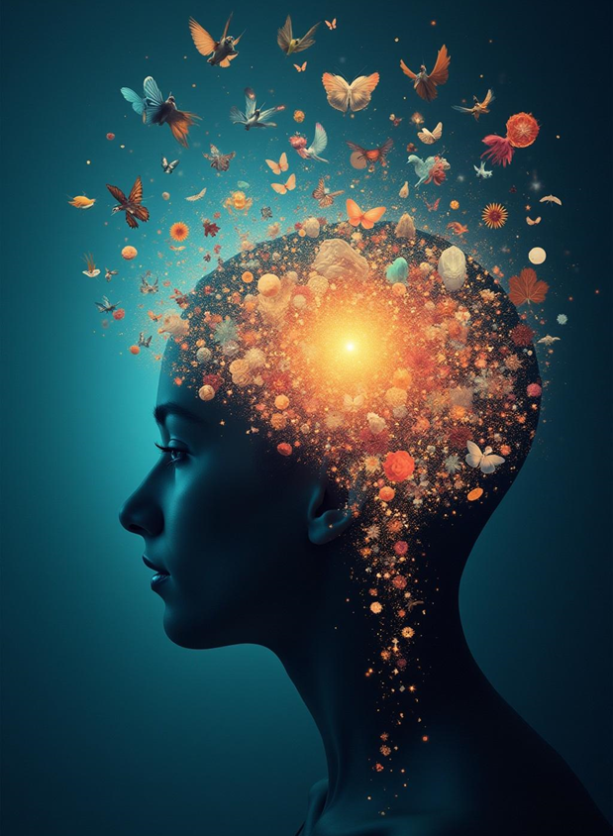

What is Mental Illness?
  Mental illnesses are health conditions involving changes in emotion, thinking or behavior (or a combination of these).

Slide 6
What is Mental Illness?
Refers collectively to all diagnosable mental disorders(AMI or SMI)
Mental illnesses must be treated

Slide 7
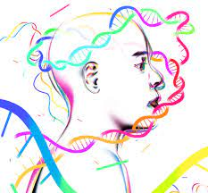

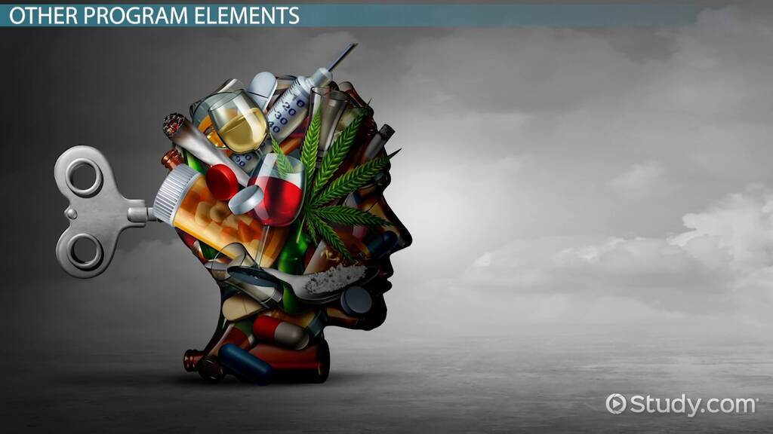
What Causes Mental Illness?
Genetics?
Trauma?
Drug Use?

Slide 8
Trauma
Car Accident
Natural Disasters
Childhood Trauma
COVID-19

Slide 9
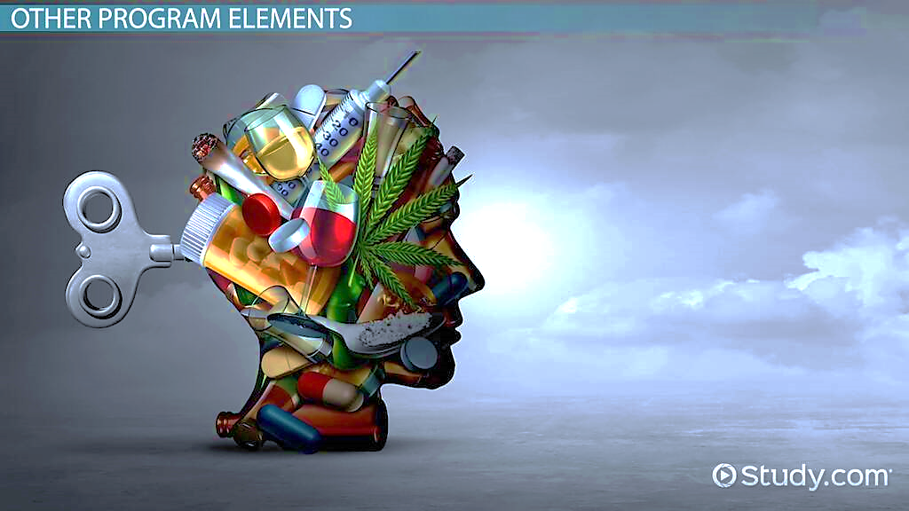
Drug Use
  Short- and long-term changes in the brain can lead to mental health issues:
  paranoia
  depression
  anxiety
  aggression
  hallucinations
  and other problems

Slide 10
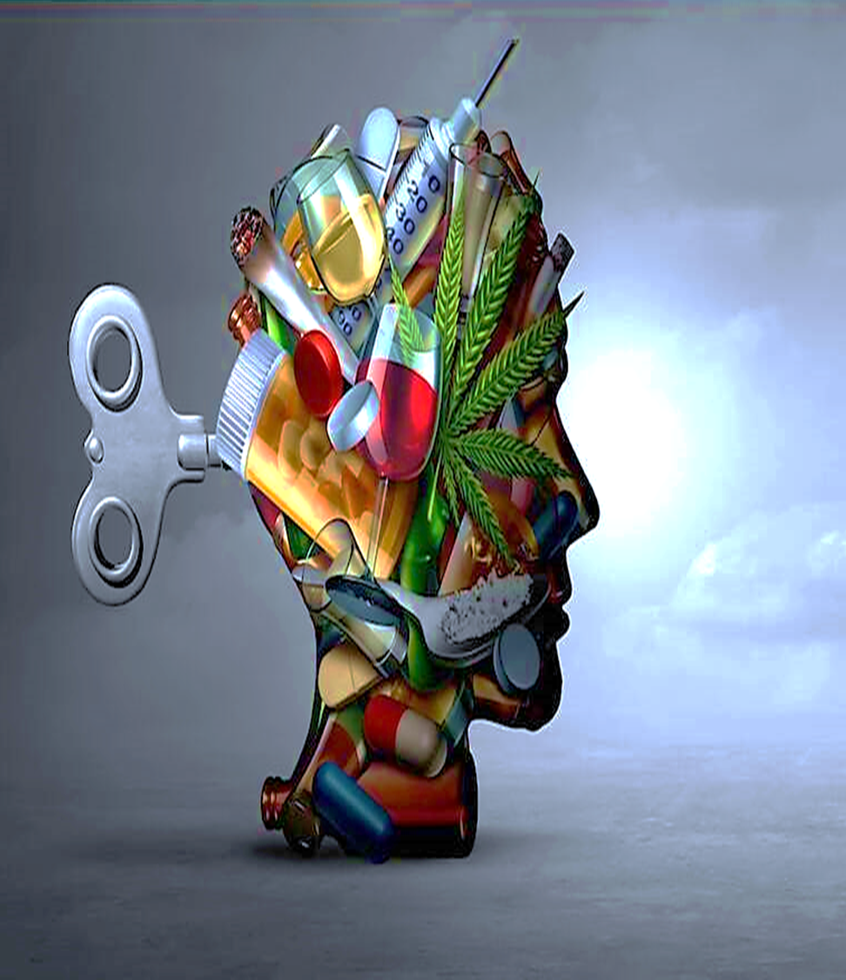
Co-Occurring:
The coexistence of both a mental illness and a substance use disorder.
Disorder and Substances
Depression and Alcohol
Anxiety and Benzodiazepines
PTSD and Opioids

Slide 11
Genetics
Some psychiatric disorders may have a shared or common genetic risk.
Autism
Attention Deficit Hyperactivity Disorder (ADHD)
Bipolar Disorder
Major Depression
Schizophrenia

Slide 12
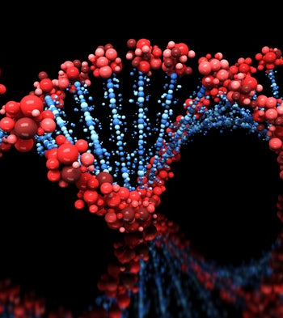
There isn’t one specific gene or genetic makeup that causes
Mental Illness

Slide 13
Commonly Diagnosed Mental Illnesses
Commonly Diagnosed Mental Illnesses
Anxiety Disorder
Generalized Anxiety Disorder
Panic Disorder
Social Anxiety
Depression
Seasonal Affective Disorder
Substance/Medication-Induced Depressive Disorder
Postpartum Depression
Notes:
Tip:
When using complex image as full-bleed background add a transparency (70%-90%) fill layer to give contrast to text.

Slide 14


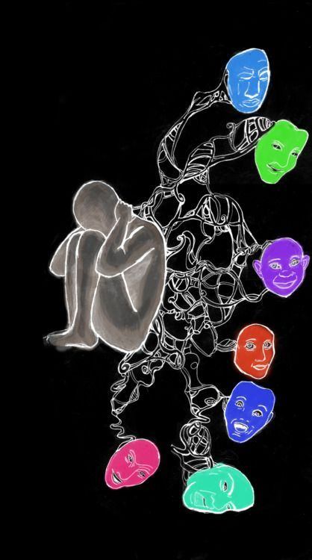
Signs & Symptoms of Mental Illness
Drop in functioning
Problems thinking
Increased sensitivity
Apathy
Feeling disconnected
Illogical thinking
Nervousness
Unusual behavior
Sleep or appetite changes
Mood changes
Withdrawal

Slide 15
Stigma & Mental Illness
Stigma involves negative attitudes or discrimination against someone based on a distinguishing characteristic such as a mental illness, health condition, or disability.

Slide 16
Stigma & Mental Illness
Public stigma involves the negative or discriminatory attitudes that others have about mental illness.
Self-stigma refers to the negative attitudes, including internalized shame, that people with mental illness have about their own condition.
Institutional stigma is more systemic, involving policies of government and private organizations that intentionally or unintentionally limit opportunities for people with mental illness.

Slide 17



Pathway to Mental
Wellness
Seek Professional Help
Stay Physically Active
Stay Connected with Loved Ones

Slide 18
Pathway to Mental Wellness
Psychotherapy Talk therapy is basically speaking with a trained therapist who can help you understand certain feelings and behaviors you may be experiencing.
Your pathway to mental wellness may be different from others. That’s okay!
Exercise Improves mental health by reducing anxiety, depression, and negative mood and by improving self-esteem and cognitive function.
~The National Institute of Health
Staying connected to loved ones may help reduce stress, anxiety, and depression. And build an emotional support system for you.

Slide 19
Pathway to Mental Wellness
Stress Management
Stress is a state of mental or emotional strain or tension resulting from adverse or very demanding circumstances.

Slide 20
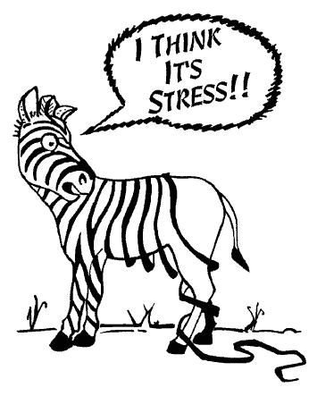
Pathway to Mental Wellness
Identify stressors

Slide 21
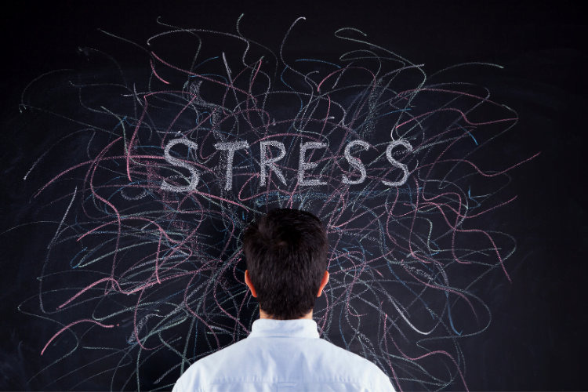
Pathway to Mental Wellness
Address the Stress

Slide 22

YOU CAN’T CONQUER
WHAT YOU REFUSE TO CONFRONT

Slide 23
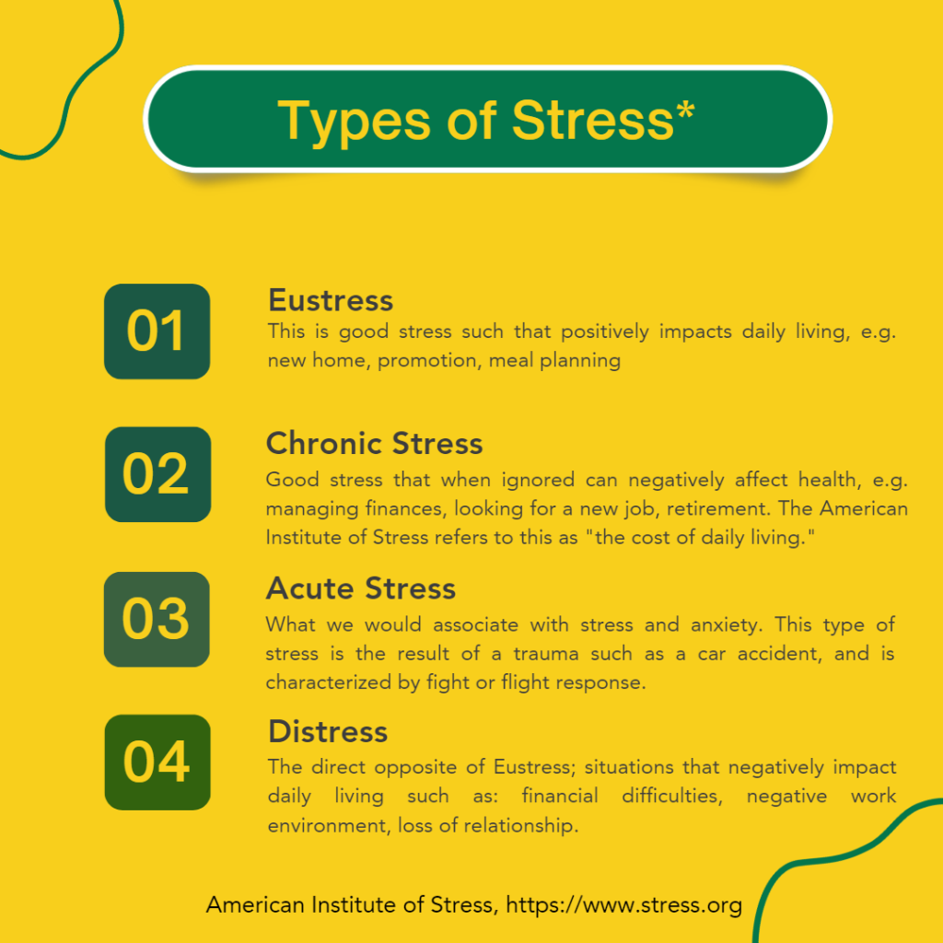

Slide 24
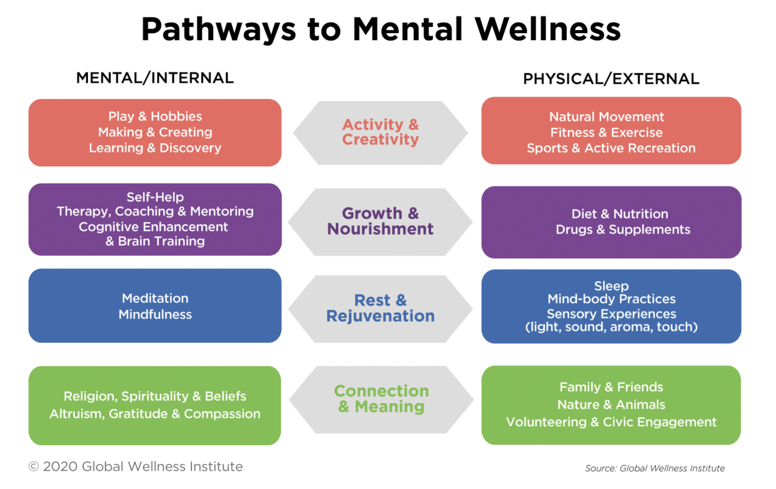

Slide 25

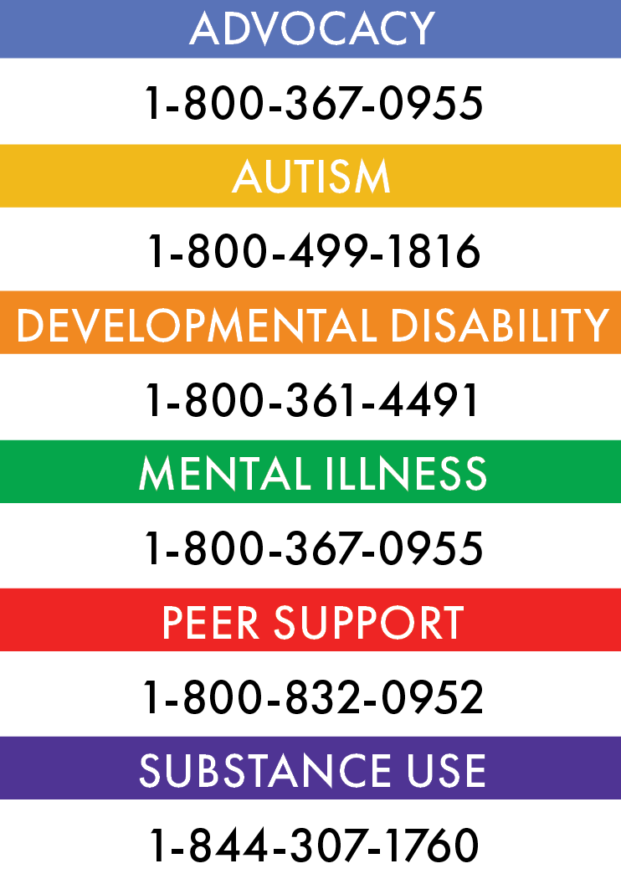
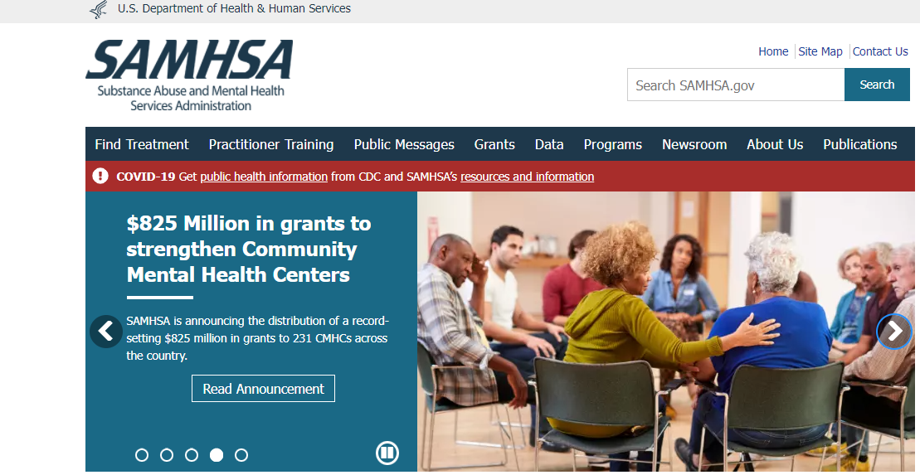
Mental Health Resources
Substance Abuse and Mental Health Services Administration
National Alliance on Mental Illness (NAMI)
Alabama Department of Mental Health

Slide 26
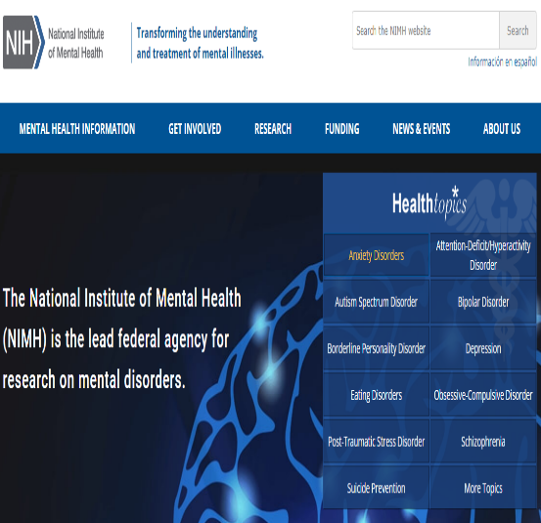
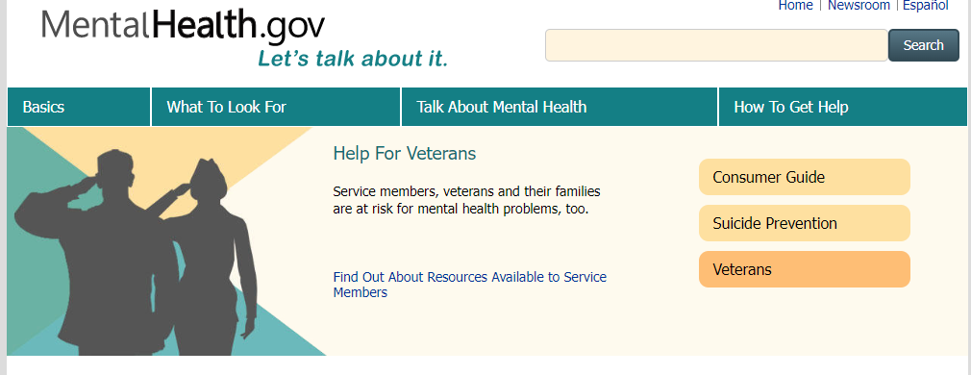

Mental Health Resources
National Institute of Mental Health
Mental Health America
MentalHealth.gov

Slide 27


        Your mental health is important.
        Identify & understand your feelings.
        Don’t delay! It’s okay to ask for help.
Notes:
Combine an image and multiple key statements with a strong grid.

Slide 28
“Establish your courage. Activate your strength.
Cultivate your will to mental wellness.”
~Dr. Kwatasian P. Hunt, PhD, MS, ICPS, AMHFA

Slide 29
References
Corrigan, P. W., & Watson, A. C. (2002, February). Understanding the impact of stigma on people with mental illness. https://www.ncbi.nlm.nih.gov/pmc/articles/PMC1489832/. Retrieved from https://www.ncbi.nlm.nih.gov/pmc/articles/PMC1489832/.
Mandal, S. P., Arya, Y. K., & Pandey, R. (2011). Mindfulness, Emotion Regulation and Subjective Well-Being: An Overview of Pathways to Positive Mental Health, 8, 159–167.
The Lancet Editorial. The health crisis of mental health stigma. The Lancet, 2016, 387:1027.
https://www.womenshealth.gov/mental-health/mental-health-conditions/anxiety-disorders#
https://adaa.org/understanding-anxiety/generalized-anxiety-disorder-gad
https://www.nimh.nih.gov/health/topics/anxiety-disorders
https://www.cdc.gov/nchs/products/databriefs/db378.htm
https://www.psychiatry.org/patients-families/stigma-and-discrimination

Slide 30




THANK YOU!
Kwatasian P. Hunt, PhD, ICPS, AMHFA, QPR-SPG
Employee Assistance Program, Director
Department of Finance Division of Risk Management
Phone: 334-223-6153
Fax: 334-223-6170
kwatasian.hunt@finance.alabama.gov

