Slide 1
Bridging Divides: Respect & Working Together
August 2022

Slide 2
State Employee Assistance Program
This presentation is part of the services provided by the State Employee Assistance Program through Behavioral Health Systems, Inc. The State EAP is administered and managed by the State Department of Finance’s Division of Risk Management (DORM). If you have questions regarding the policy, procedures or services provided by this program, please contact the Program Coordinator, Kwatasian Hunt, at eap.information@finance.alabama.gov. You can also find more information about the State Employee Assistance Program on the Division of Risk Management’s website at www.riskmgt.alabama.gov.
Notes:
IMPORTANT PLEASE READ

Slide 3
Objectives
Recognize the value and challenges of diverse interactions
Understand the factors involved in disrespect, harassment and bullying
Explore positive response strategies
Review State of Alabama’s EAP benefits

Slide 4
Embracing Diversity
“A diverse mix of voices leads to better discussions, decisions, and outcomes for everyone.”
-Sundar Pichai
Notes:
So what does that include?

Slide 5
What is Diversity?
Understanding that each individual is unique, and recognizing our individual differences. These can be along the dimensions of race, ethnicity, gender, sexual orientation, socio-economic status, age, physical abilities, religious beliefs, political beliefs, or ideologies

Slide 6
Advantages of Workforce Diversity
Creativity increases when people with different ways of solving difficult problems work together towards a common solution
Productivity increases exponentially when people of all cultures pull together towards a single inspiring goal
New attitudes are brought to the business table by people form diverse cultures

Slide 7
Advantages of Workplace Diversity
Language skills are needed for today’s increasing global economy and diverse workers often have this proficiency
By relating to people of all backgrounds, Americans will gain a greater perspective on how different cultures operate and experience greater success in global business
New processes can result when people with different ideas come together and collaborate. Workers must bring multiple skills to the environment, think cross- culturally, and adapt quickly to new situations

Slide 8
Barriers to Workplace Diversity
We’re afraid our own perspective won’t be good enough
We invite the wrong people to the table
Deep cultural problems within the organization have not been addressed

Slide 9
Actions to Overcome Barriers
Host a meeting. Start by identifying an issue in need of resolution and invite key influencers to the meeting
Abandon “right and wrong.” Instead reframe right and wrong to what “will work” or “won’t work” for the matter at hand
Practice inclusion without illusion. Don’t just implement inclusion initiatives for the sake of best practices. Do so out of genuine curiosity and interest

Slide 10
Workplace Bullying: Awareness, Prevention & Intervention

Slide 11
Workplace Bullying
Workplace bullying occurs when one person or group of people intentionally inflict pain or harm on another person in the workplace
Workplace bullying can include such tactics as verbal bullying, physical bullying, internet bullying or sexual bullying

Slide 12
Why Employees Bully Each Other
A bully’s behavior is usually driven by a need to control
These employees want to call the shots and often insist on having things their way
Many times, these bullies relate well to others and have a lot of influence with the company. As a result, they use these behaviors to control other people

Slide 13
Why Employees Bully Each Other
Sometimes workplace bullies target their co-workers out of jealousy
When this happens, the bullying plan is an attempt to reduce the target’s recognition by turning others against them
Other times, workplace bullying occurs because the bully has poor impulse control
When this happens, the bullies are likely to use direct insults and negative comments

Slide 14
How Bullying Affects Organizations
Consequences for bullying can be very costly:
Replacing staff members that leave as a result of bullying
Work not properly or timely completed as staff cope with bullying incidents
Costs associated with investigations of bullying and potential legal action

Slide 15
Keys to Workplace Professionalism

Slide 16
Professionalism 101
The Combination of
Image – How people see you
Communication – How well you communicate
Competence – How well you perform
Demeanor – How you carry yourself

Slide 17
Professionalism 101
Professionalism is not:
Letting your ego take over
Blaming others
Bringing drama to situations
Losing your cool during stressful times
Making excuses
Having a bad attitude

Slide 18
What is a Respectful Workplace?
In a respectful workplace:
Employees are valued
Communication is kind, open and honest
People are treated as they wish to be treated
Disagreements are addressed in a positive and respectful manner
Disrespectful behavior is addressed

Slide 19
What is NOT a Respectful Workplace?
An environment where:
People yell at others or use offensive words
People blame others without facts or reason
People refuse to work with another employee or group of employees
People take credit for work they did not complete
People disrupt meetings with sarcasm or insults

Slide 20
Effects of “Disrespect”
Individual
Feelings of frustration
Anger & helplessness
Loss of confidence
Inability to sleep
Panic & anxiety
Depression
Inability to concentrate
Workplace
Increased absences from work
Increased employee changes
Increased risk of injury
Decreased productivity

Slide 21
Respecting Our Differences
Working with different types of employees is vital because it leads to a great reputation for the company, which in turn, leads to increased profits and opportunities for workers
Working with different personalities, at different stages of their career, can help with creativity by bringing a variety of ideas to the table

Slide 22
When Employees Disagree
Employees will not get along from time to time because of differences in their personalities, lifestyles, opinions or any number of reasons
When there is unresolved disagreement in the workplace, it affects everybody

Slide 23
When Employees Disagree
The unpleasant atmosphere not only makes the office environment uncomfortable – it can also negatively impact business productivity
When handled correctly, employee disagreements can lead to healthy competition and better ways of getting things done

Slide 24
Employees’ Role in Creating a Respectful Workplace
All employees are encouraged to address disrespectful behavior when it happens, tell the person to stop
Refuse to participate in disrespectful behavior
Support colleagues who are the target of that behavior
Be aware of your role in allowing disrespectful behavior
Report to supervisor when necessary

Slide 25
Leaders’ Role in Creating a Respectful Workplace
If you observe someone being treated in a humiliating, degrading or disrespectful manner, address the issue
Discipline where appropriate
Provide consistent discipline to employees

Slide 26
Creating a Workplace of Positive Communication

Slide 27
What is Good Communication?
Good Communication can:
Help us work together
Help us get the job done right
Prevent arguments

Slide 28
What is Good Communication?
Thinking before speaking
Taking the time to think about what you want to say
Having confidence
Practicing before time so you feel comfortable with the information
Being aware of how you stand or move your hands while speaking

Slide 29
What is Good Communication?
Being clear
Avoid using big words if you don’t know what they mean
Pronounce words so that people can understand what you are saying
Changing how loud or how soft you speak
This makes listening to you more interesting
Make certain parts more important by speaking softer or louder for emphasis

Slide 30
Good Communication
Good communication includes:
Listening
Being aware of body language
Managing stress
Learning from your emotions
Respecting others

Slide 31
Listening
Tips for being an good listener:
Pay attention to the person speaking
Do not interrupt the speaker
Show your interest

Slide 32
Being Aware of Body Language
Understanding your body language can help you:
Connect with others
Say what you really mean
Work through problems
Build better relationships at work and at home

Slide 33
Being Aware of Body Language
Positive body language includes:
Maintaining eye contact
Standing still with back straight
Using positive body movements

Slide 34
Managing Stress
Managing your stress can improve your communication by:
Being in control of your feelings
Being able to control your behavior during a time of stress or during a disagreement

Slide 35
Managing Stress
To manage stress while communicating:
Know what upsets you
Take a moment to calm down, slow down
Look for humor in the situation
Agree to disagree

Slide 36
In Summary: Learning From Your Emotions
Being able to recognize your emotions helps you:
Understand from others point of view
Stay motivated
Communicate clearly and effectively
Build strong, trusting and rewarding relationships
Think creatively, solve problems and manage disagreements

Slide 37
In Summary: Learning From Your Emotions
Not being aware of your emotions will affect your ability to:
Fully understand others
Problem solve
Resolve disagreements
Build connections with others

Slide 38
In Summary: Respecting Others
Each team member is equally important
Each team member’s work is equally important
Each team member has the right to be heard

Slide 39
In Summary: Small Changes Can Have a Big Impact
Respect one another
Filter your communication
Choose your words wisely
Avoid inappropriate comments
Be positive & remain calm
Recognize that the world is made of individuals with various viewpoints and life experiences
Seek to be better every day

Slide 40
Review of Your BHS Benefits
State of Alabama

Slide 41
About BHS: At a Glance
30+ Years in Business
750,000+ Covered Lives Nationally
87% Client Retention
Employee-Owned
Birmingham, AL Headquarters; Midwest Regional Office (Chicago)
96% Patient Satisfaction Rate
“Open” Preferred Provider Network of 100,000+ Providers
3% Staff Turnover Rate
Our mission
To provide comprehensive behavioral health services to employers and their beneficiaries which are high quality, cost effective, uniformly accessible, and managed within a least restrictive treatment approach.

Slide 42
State of Alabama: EAP Benefits
All employees and dependents may receive up to three (3) visits/consults at no charge each year.
Behavioral
Speak with Counselors
Referrals for mental/ behavioral health & substance abuse issues
Financial
Speak with Advisors
Assistance with budgeting, estate planning, college, debt restructuring, etc.
Eldercare
Speak with Professionals
Help with nursing home & assisted living placement, caregiver issues, etc.
Well-Being
Speak with Work/Life Specialists
Help with stress, emotional health, work/life balance, etc.

Slide 43
Accessing the EAP
Begins with a call to BHS: 800-245-1150
BHS Care Coordinator is available Monday-Friday from 7:30 a.m. – 5:00 p.m. CT
Your BHS Care Coordinator will:
Verify personal information to confirm benefit eligibility
Ask a few questions about needs and preferences
Assist in referring to the appropriate counselor or provider
After hour, weekend and holiday calls answered by licensed mental health professionals – never an automated response system

Slide 44
Accessing the EAP
Dedicated BHS Care Coordinator
When you call BHS, you will speak with the BHS Care Coordinator assigned specifically to the State of Alabama
Marie Wilbanks / Emme Blankenship Care Coordinator
1-800-245-1150
BHS Care Coordinators
Caring, knowledgeable, credentialed counseling professionals who have been selected for their commitment to treat everyone with sensitivity, respect and concern

Slide 45
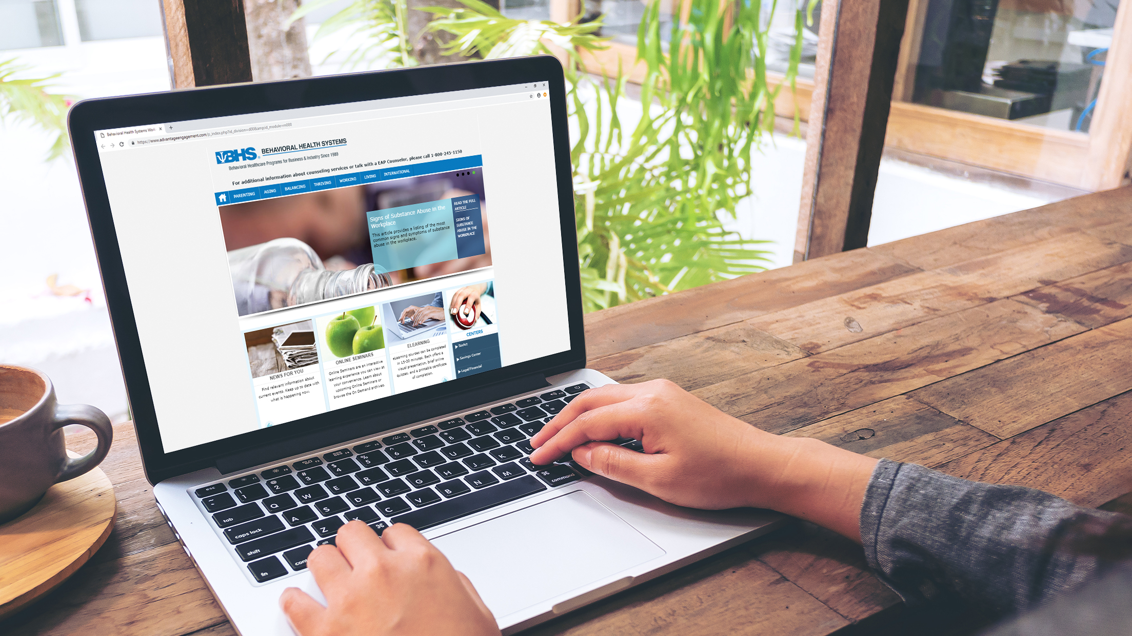
BHS Website:
www.behavioralhealthsystems.com
Access to:
Enhanced Member Section detailing your unique benefits and services (Member Access)
Member Tips & Resources
Self-Assessment Tools
Appointment Requests
Online Work/Life (password: DORM):
Lifestyle tools to support a healthy work/life balance
Extensive library providing access to relevant articles, seminars, self-help information, news items and more

Slide 46
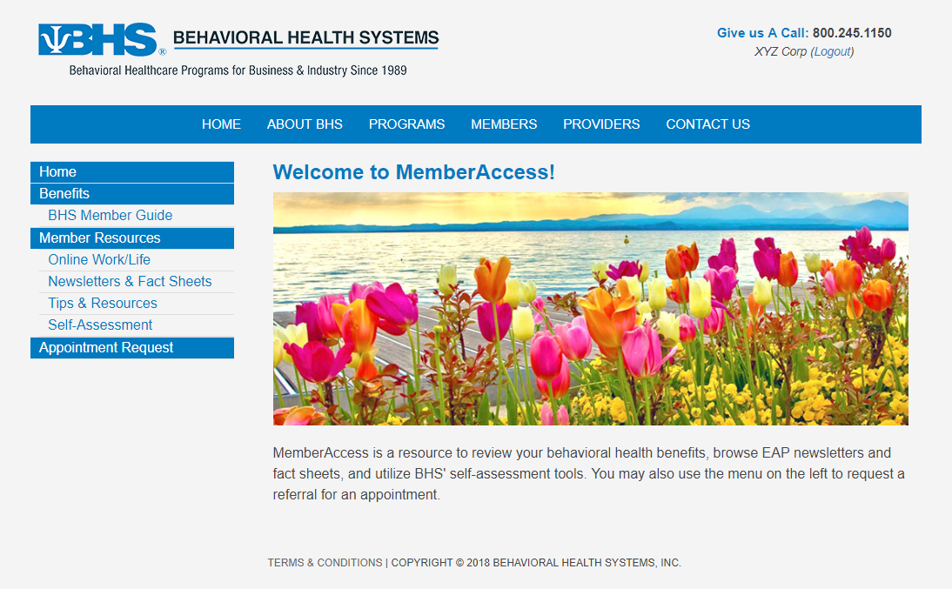
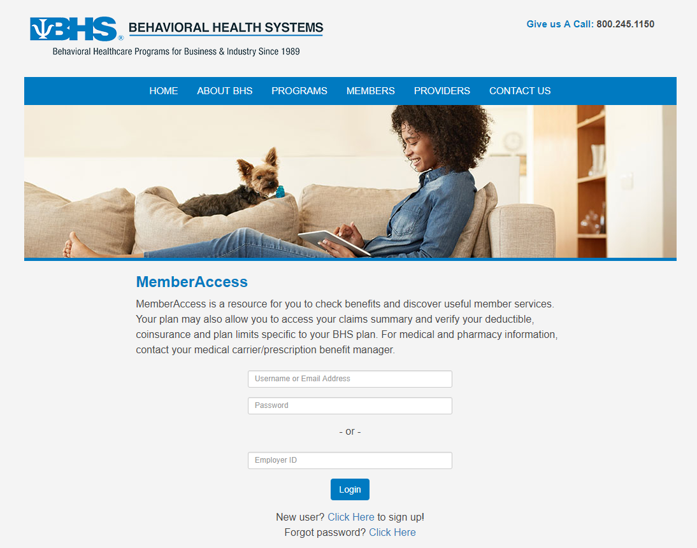
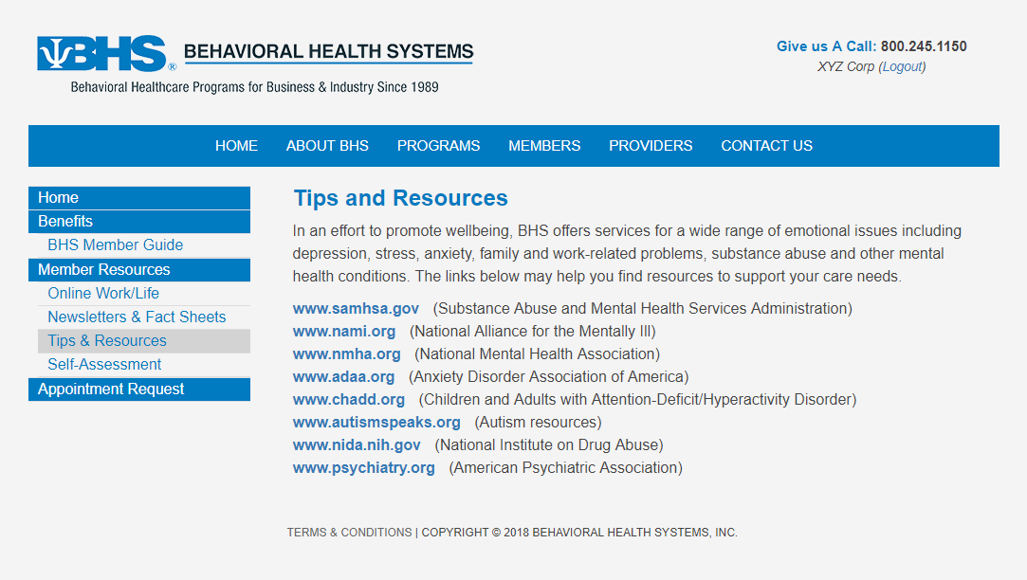
More Information About Your EAP Benefit www.behavioralhealthsystems.com
BHS Website
Resources
Access to:
Benefit Information
Member Tips & Resources
Self-Assessment tools
Newsletters & Fact Sheets
Appointment Requests
Two ways to login to MemberAccess:
Use your Employer ID: DORM
Create a unique user login
Notes:
More information about your EAP benefit is available at our website. Enter the Members section, click on Member Login and enter your password, DORM, to view your member guide and to use self-assessment tools.

Slide 47
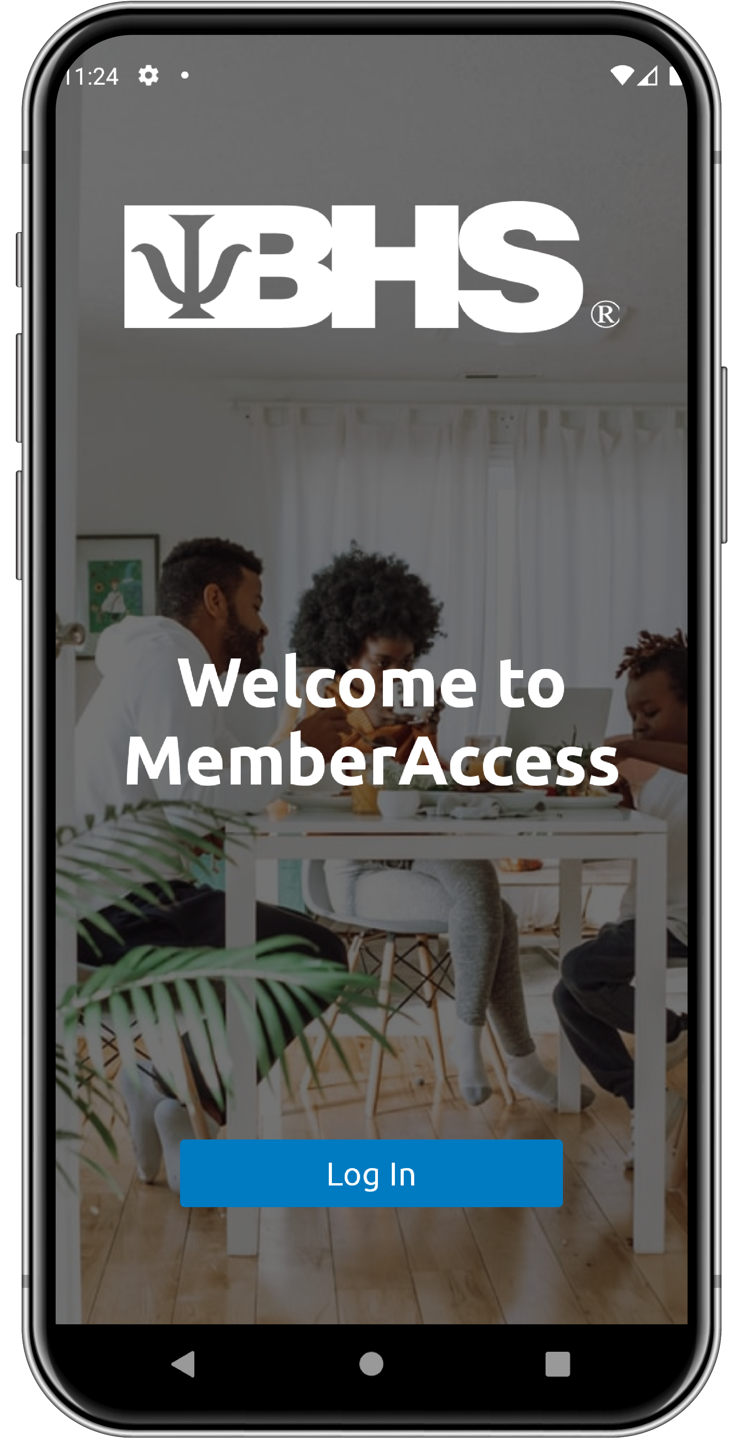
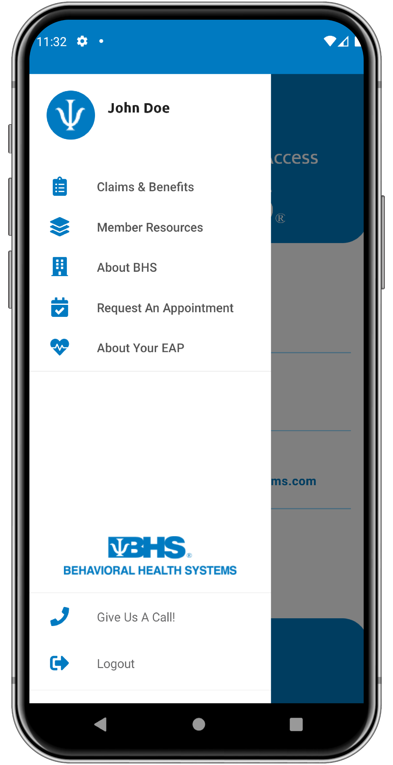
Introducing BHS MemberAccess Mobile App
Now Available!
Now it’s Easier Than Ever to Access…
Benefit Information
Member Tips & Resources
Self-Assessment Tools
Newsletters & Fact Sheets
Appointment Requests
Reimbursement Forms
Online Work/Life
Two ways to login:
Use your Employer ID: DORM
Create a Unique User Login

Slide 48
Bridging Divides: Respect & Working Together
August 2022

